Slide 1

Day 1
Automation Architect- Shrish Tripathi

Slide 2
Agenda
Automation Vs Development
Why Automation?
Latest Industry Trends-Automation
Automation Testing Process
Key Factors or Building Block in Automation
Why we need Type Scripts
Why we need protractor ?
What is AngularJS App?
Environment Setup
Quiz or Assignment

Slide 3
Automation vs Development
Technically there is not much difference.
Both involve writing and managing code using various tools or in different languages
Development -> Application development is the process of creating a set of programs to perform the different tasks that a business requires
Automation -> Test automation is the use of special software (Selenium, Protractor, UFT etc.) to control the execution of tests in Application and the comparison of actual outcomes with predicted outcome

Slide 4
Why Automation ?
If you want to repeat and test any task in your application
If you want to reuse and test any set of task in your application
Reduce the Cost
Quality Coverage
Speed to Deliver

Slide 5


Slide 6
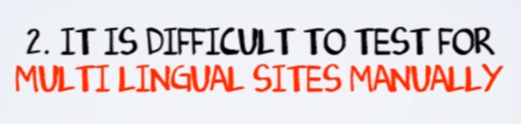

Slide 7
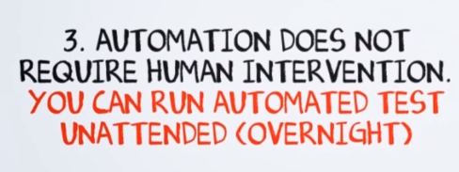

Slide 8
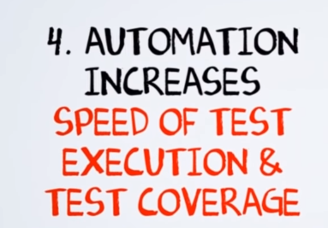

Slide 9


Slide 10


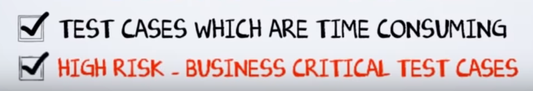

Slide 11



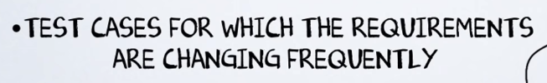

Slide 12
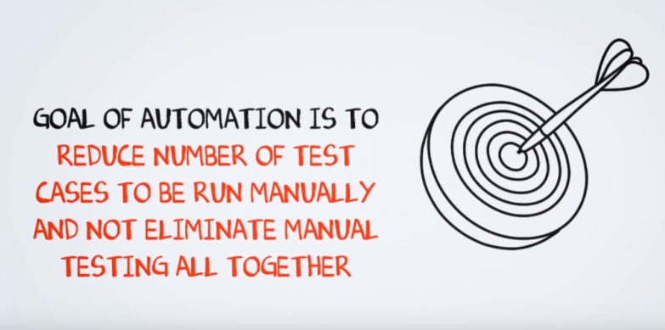

Slide 13
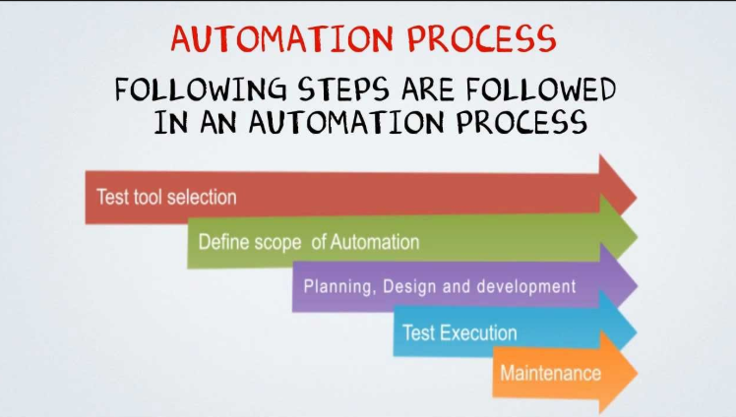

Slide 14


Slide 15
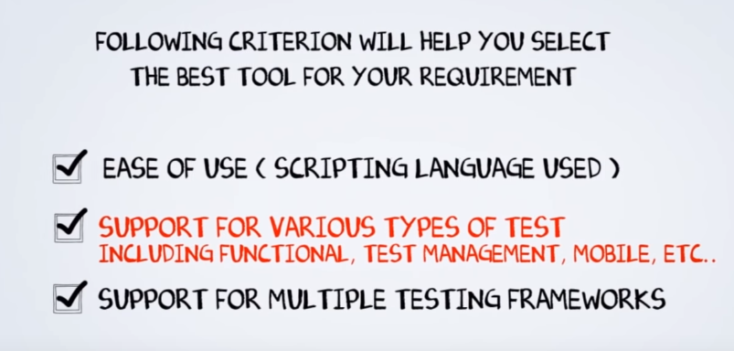

Slide 16
AUTOMATION TOOLS (SOFTWARES)

Slide 17
AUTOMATION TOOLS (SOFTWARES)
QTP
Selenium
Ranorex
Protractor
lot more……
AUTOMATION TOOLS IN MARKET?
LICENSED (more User friendly, High Cost)
OPEN SOURCE (less user friendly, Free of Cost)
EVERY TOOL HAS OWN REASON OF EXISTENCE
SELENIUM AND PROTRACTOR – THEY ARE NOT TOOLS..JUST SOFTWARE PACKAGE/API’S

Slide 18
KEY FACTORS IN AUTOMATION
LOCATORS
AUTOMATION TOOLS ( API/SOFTWARES/PACKAGE etc.)
PROGRAMMING LANGUAGE
FRAMEWORK(PUT EVERYTHING IN STRUCTURED WAY)

Slide 19
LOCATORS

Slide 20
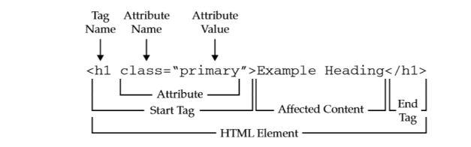
Locators Definition

Slide 21
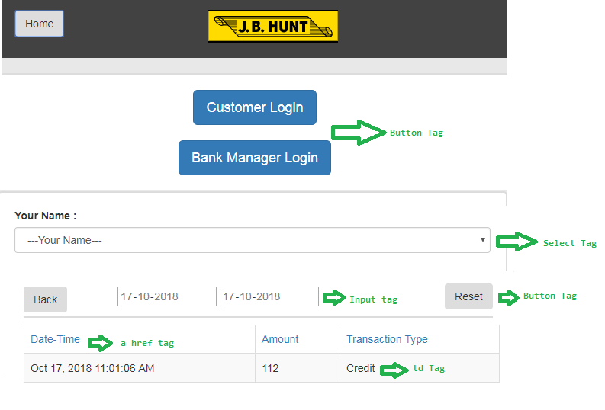
Tags

Slide 22
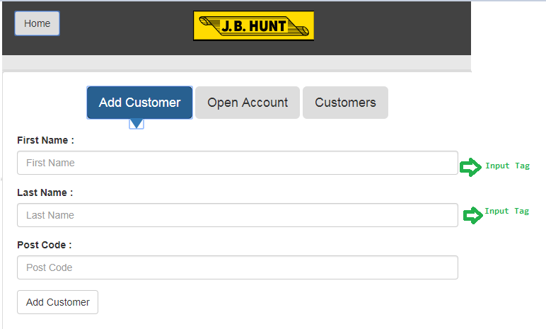
Tags Contd..

Slide 23
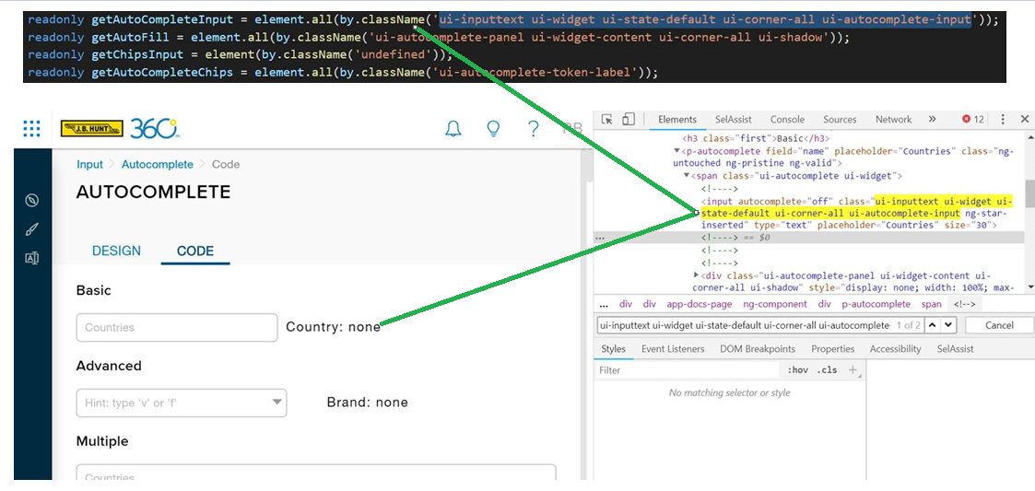
Sample Locator

Slide 24
Lets Understand Locators in detail

Slide 25
Locators Cheat Sheet
For Reference;
https://devhints.io/xpath

Slide 26

What is AngularJS Application?
AngularJS is a JavaScript framework. It can be added to an HTML page with a <script> tag. AngularJS extends HTML attributes with Directives, and binds data to HTML with Expressions.

Slide 27
Single Page Application (SPA)
A single-page application is a web application or web site that interacts with the user by dynamically rewriting the current page rather than loading entire new pages from a server

Slide 28
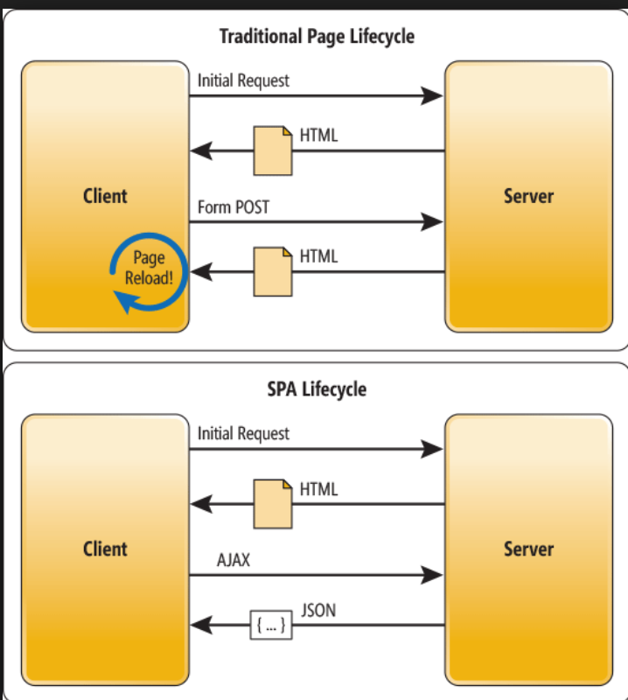

Slide 29
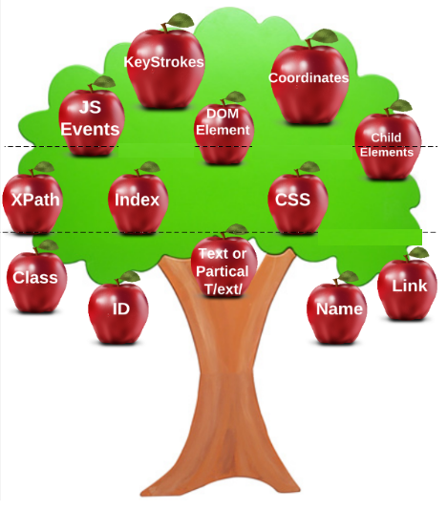

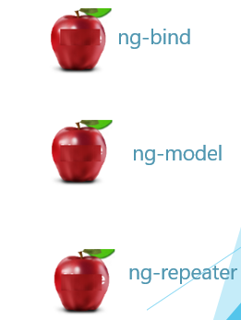
Add Angular specific Locators
Lot more….

Slide 30
Let’s Check this !!
https://www.w3schools.com/angular/angular_application.asp

Slide 31
Assignment

Slide 32
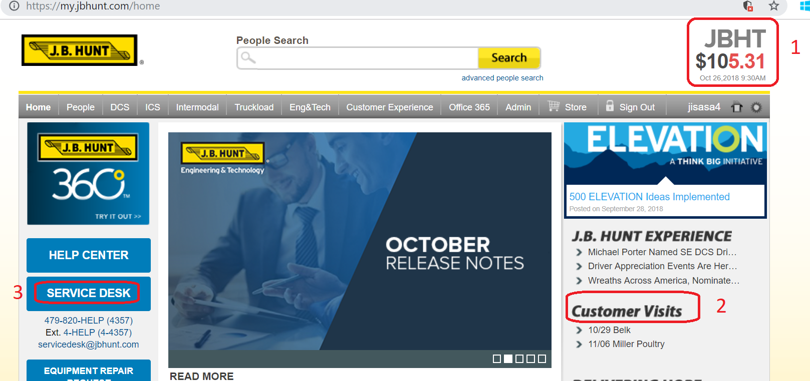

Slide 33
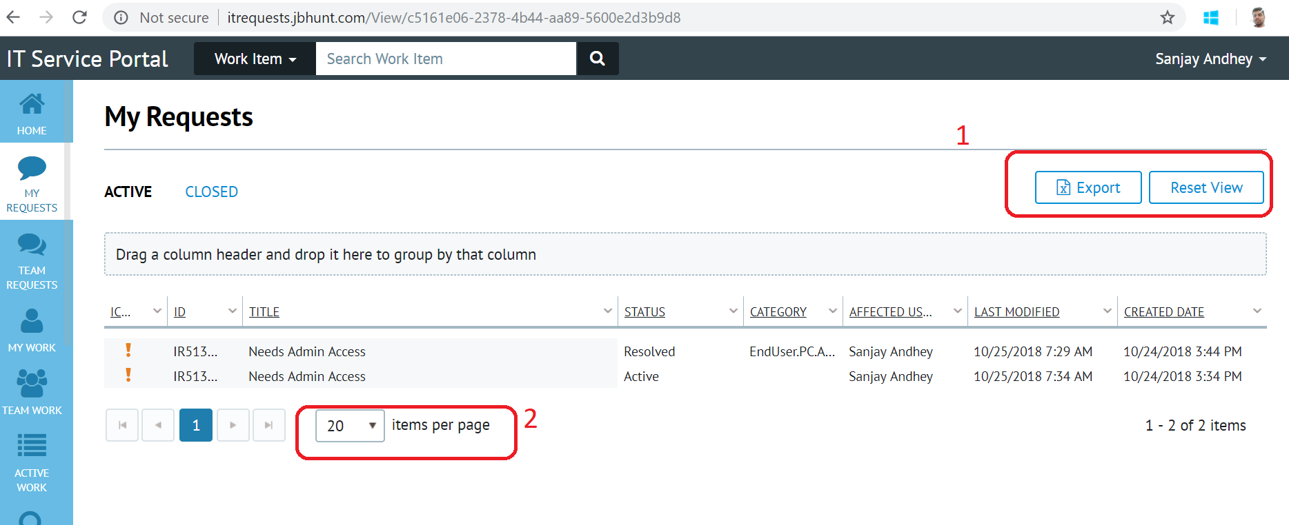

Slide 34
AUTOMATION FRAMEWORK (PUT EVERYTHING IN STRUCTURED WAY)

Slide 35
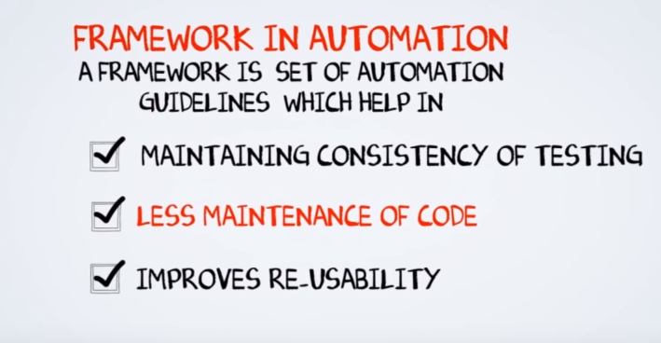

Slide 36
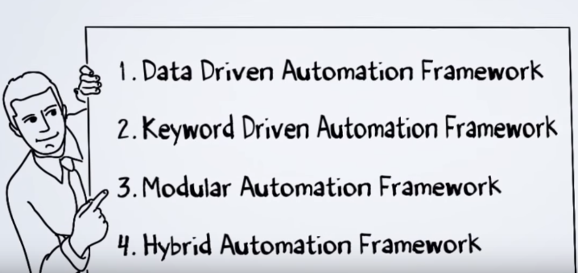

Slide 37
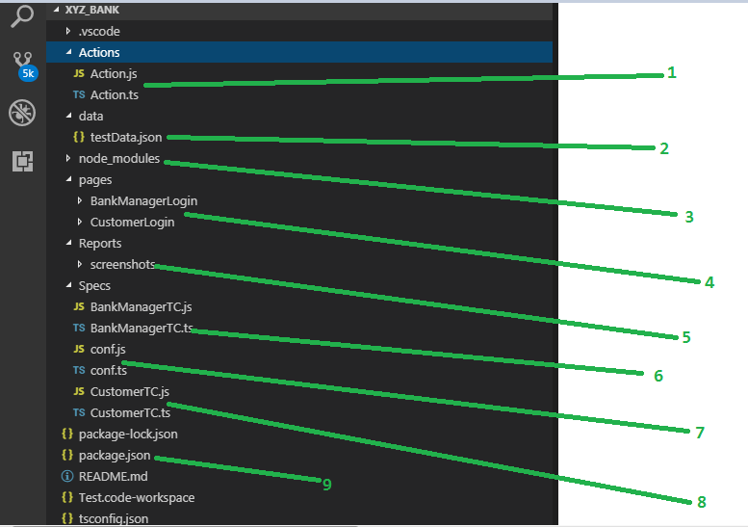
Sample Framework Structure-
All Reusable functions
Keep your all Test Data
Auto Generated node packages
Page(Project) specific Locators function
Report/Results
Testcases
Recommended Testcase setup for execution
Update all Dependencies
Testcases

Slide 38
PROGRAMMING LANGAUGE
JAVA
C#
VBSCRIPT
JAVASCRIPT
TYPESCRIPT

Slide 39
Why TypeScript? Why Not JavaScript?

Slide 40
TypeScript is a superset of JavaScript.
TypeScript language includes the entire JavaScript language plus a collection of useful additional features
Strong Typing
OOPS

Slide 41
Let’s Connect everything…
Selenium
Webdriver (Chrome,IE,Forefox)
WebdriverJS -> Node.js
Protractor
JavaScript
TypeScript

Slide 42
Why Protractor ? Why not Selenium?

Slide 43
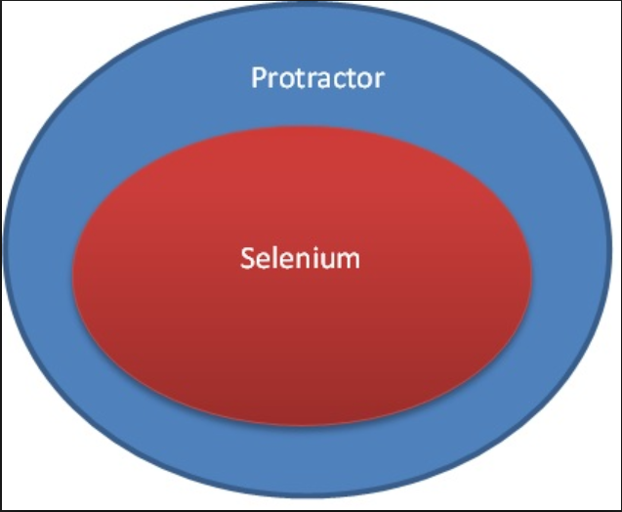

Slide 44
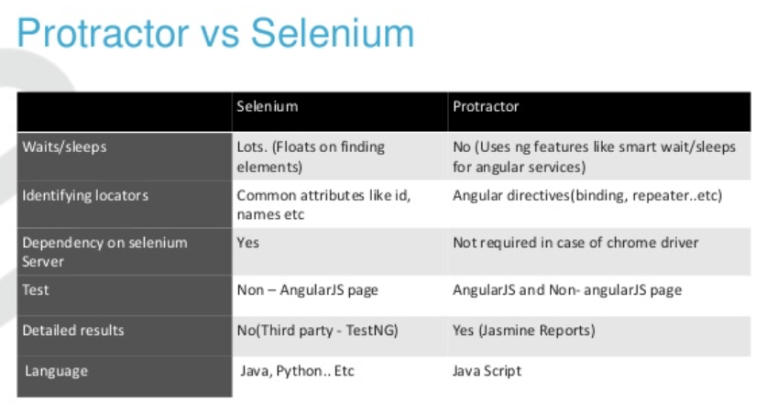

Slide 45
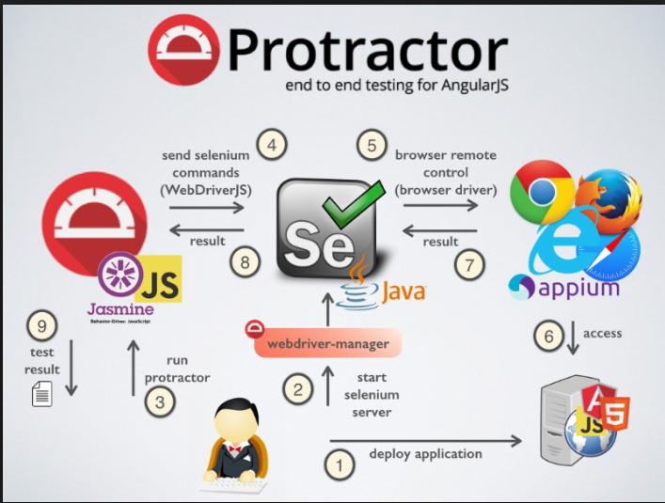

Slide 46
Quiz

Slide 47
How to define relationship among nodes?
Parents
Children
Siblings
Ancestors
Descendents

Slide 48
What is the best Strategy for Locators?
Concise and Compact Locators.
Resilient to the Web UI Changes.
Independent to the Changes in Element Properties
All of the above

Slide 49
Which one is belong to Angular Locators specifically ?
ID
Class
Name
ng-repeater
Link Text
Partial Link Text
ng-model
Tag Name
CSS Class
Xpath
ng-binding

Slide 50
Thanks !!

Slide 51
Environment Setup for Next Session
Download node.js (npm)
Install protractor($npm install –g protractor)
Install WebdriverJS ($webdriver-manager update)
Check your JDK($Java-version)
Start your Webdriver Manager ($webdriver-manager start)
Install Visual Studio Code-VSC (IDE)
Create your Project Workspace in VSC
Run $npm init command ( Package .JSON generate under project folder)
Go to Terminal and run $ npm install (node_module,package.lock.json refreshed)

